Slide 1

CODING & DECODING
LOGICAL REASONING

Slide 2

CODING AND DECODING
Coding and decoding in logical reasoning involves converting information (words, numbers, etc.) into a coded form and then converting it back to its original form.
Coding is the process of hiding the meaning of a message by representing it in a specific code, while decoding is the process of deciphering that code to reveal the original message.

Slide 3
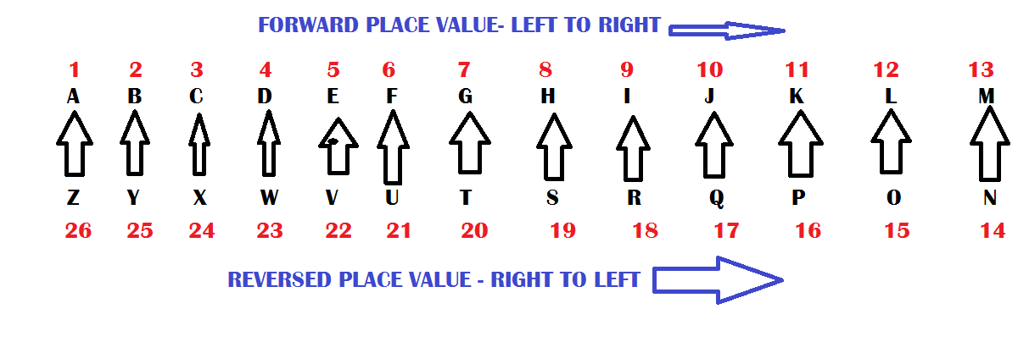
ALPHABETS WITH POSTION VALUES

Slide 4
A. RECFORT
B. TEDFNOR
C. REDFORT
D. TROFDER
1)If TSEREVE and NOITACUDE stands for EVEREST and EDUCATION, how will you code REDFORT?

Slide 5
A. NLATNOIA
B. LANOITAN
C. LNAANTOI
D. LNOINTAA
2)If CARPET is coded as TCEAPR, then the code for NATIONAL would be

Slide 6
A. DIJOBT
B. DJKRDP
C. DKMSGR
D. DCVXQK
3)If JAPAN is coded KCSES, then the code for CASTLE will be

Slide 7
A. HMPCF
B. FMPCH
C. FPMCH
D. FCPMH
4)If EARTH can be coded as ’IUSBF’ how can GLOBE be coded?

Slide 8
A. PCYQMN
B. PGYQMN
C. PGYUMP
D. PGYUPM
5)If PAINTER is written in a code language as NCGPRGP, then REASON would be written as

Slide 9
6)If in a certain code BACK is coded as 5436, LABLE is coded as 14510 what will be the code for BALL?
A. 1345
B. 5411
C. 1354
D. 2130

Slide 10
A. 81
B. 45
C. 60
D. 06
7)If DOOR = 25,
LOWER = 37,
TOWER = 18,
then OVER = ?

Slide 11
8)In a certain code language, if the value of ’INVADER’ = 42 and ’SECURE’ =30, then what is the value of ’SITUATION’?
A. 81
B. 63
C. 72
D. 90

Slide 12
9)In a certain code language, if the value of
38 + 15 = 66 and
29 + 36 = 99, then
what is the value of
82 + 44 = ?
A. 77
B. 80
C. 88
D. 92

Slide 13
10)In a code language
’How are you’ is coded as ’3 4 5’, ’Who are you’ is coded as ’4 1 3’, ’They are good’ is coded as ’6 4 9’
’She is good’ is coded as ’7 9 2’. What is the code for ’you’?
A. 3
B. 2
C. 4
D. 5

Slide 14
Which of the following is the code for ’is are’?
12)Study the following information to answer the given questions.
In a certain code
’Basic material is available’ is written
as ’de kl ce dp’.
’Basic questions are solved’ is written
as ’sa kc bk de’.
’Almost questions available solved’ is
written as ’dp fc bk sa’.
’are material good enough’ is written
as ’kl ts kc mt’.
A. kl dp
B. sa fc
C. ce de
D. ce kc

Slide 15
If ’questions make difference’ is coded as ’cl km sa’, then which of the following
is the code for ’solved are available’?
13)Study the following information to answer the given questions.
In a certain code
’Basic material is available’ is written
as ’de kl ce dp’.
’Basic questions are solved’ is written
as ’sa kc bk de’.
’Almost questions available solved’ is
written as ’dp fc bk sa’.
’are material good enough’ is written
as ’kl ts kc mt’.
A. kc bk sa
B. dp mt kl
C. bk kc dp
D. de fc dp

Slide 16
What can be the code of ’almost material unique’?
14)Study the following information to answer the given questions.
In a certain code
’Basic material is available’ is written
as ’de kl ce dp’.
’Basic questions are solved’ is written
as ’sa kc bk de’.
’Almost questions available solved’ is
written as ’dp fc bk sa’.
’are material good enough’ is written
as ’kl ts kc mt’.
A. fc bk op
B. fc de kl
C. kl op mt
D. fc kl jf

Slide 17
15)If SAND is called AIR,
Air is called PLATEAU, PLATEAU is called WELL,
WELL is called ISLAND and Island is called SKY,
then from where will a person draw water from?
A. WELL
B. ISLAND
C. SKY
D. AIR

